Slide 1





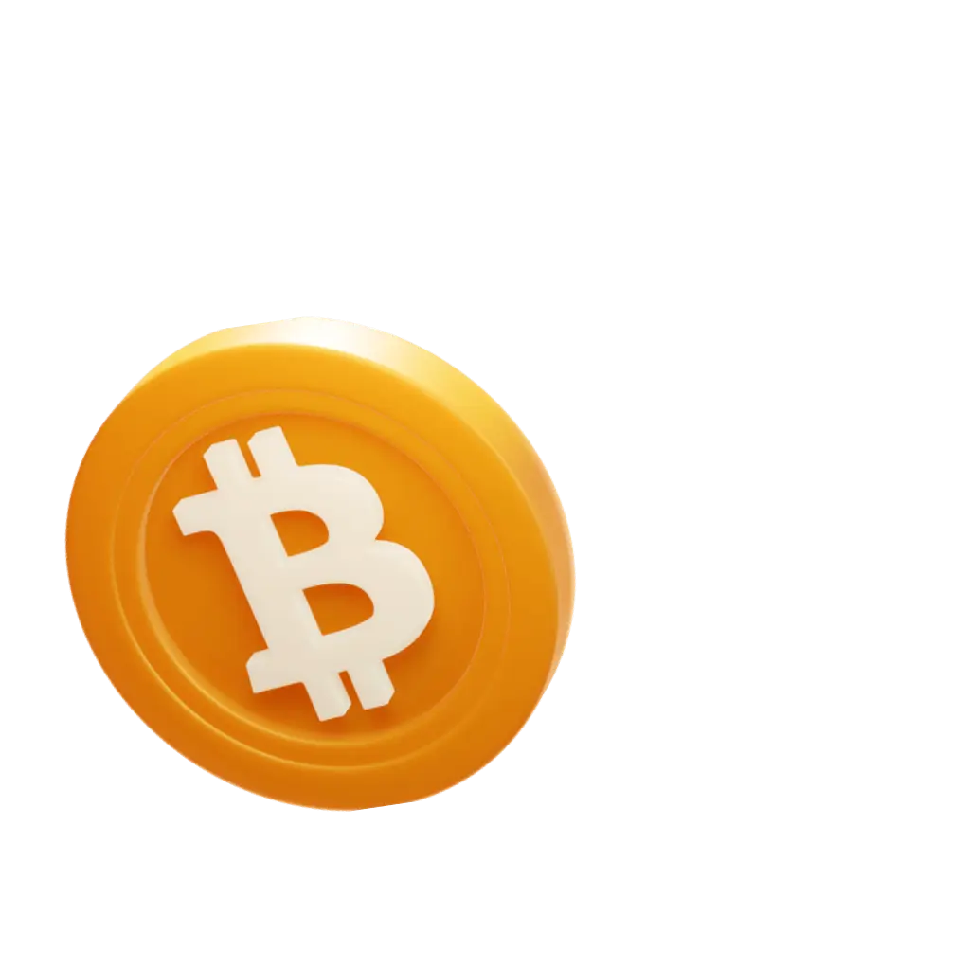

Develhope FSD - Class #4
Team #1
Shall we begin?

Slide 2


Develhope FSD - Class #4
Team #1

Slide 3

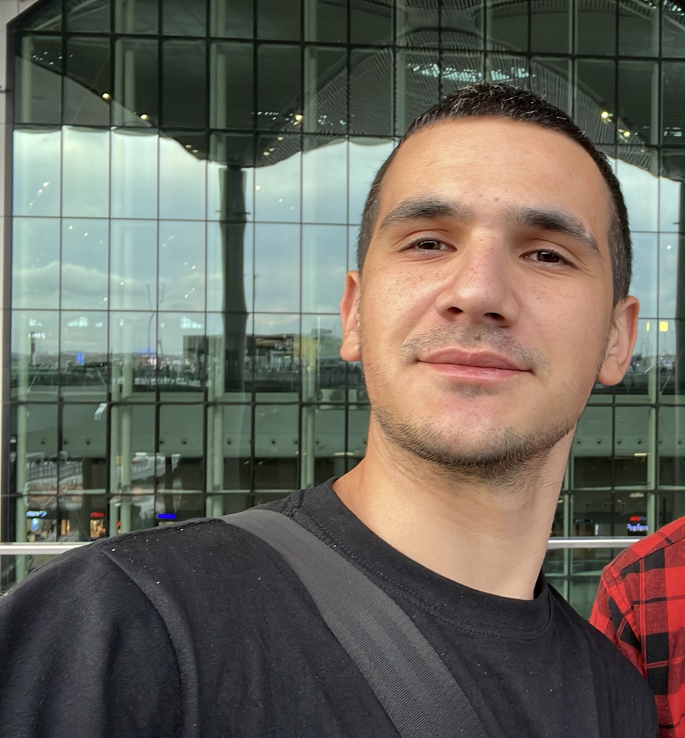
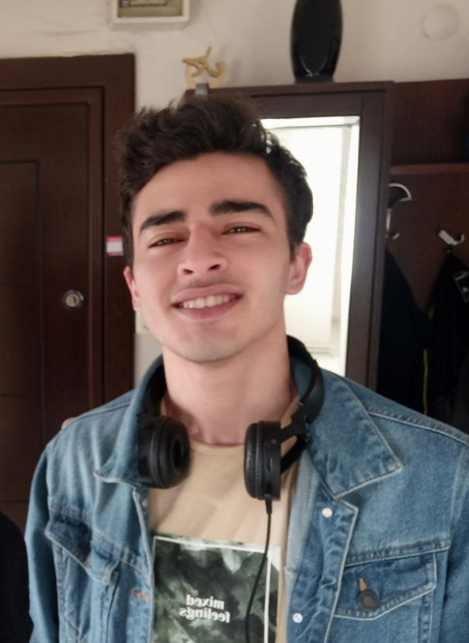

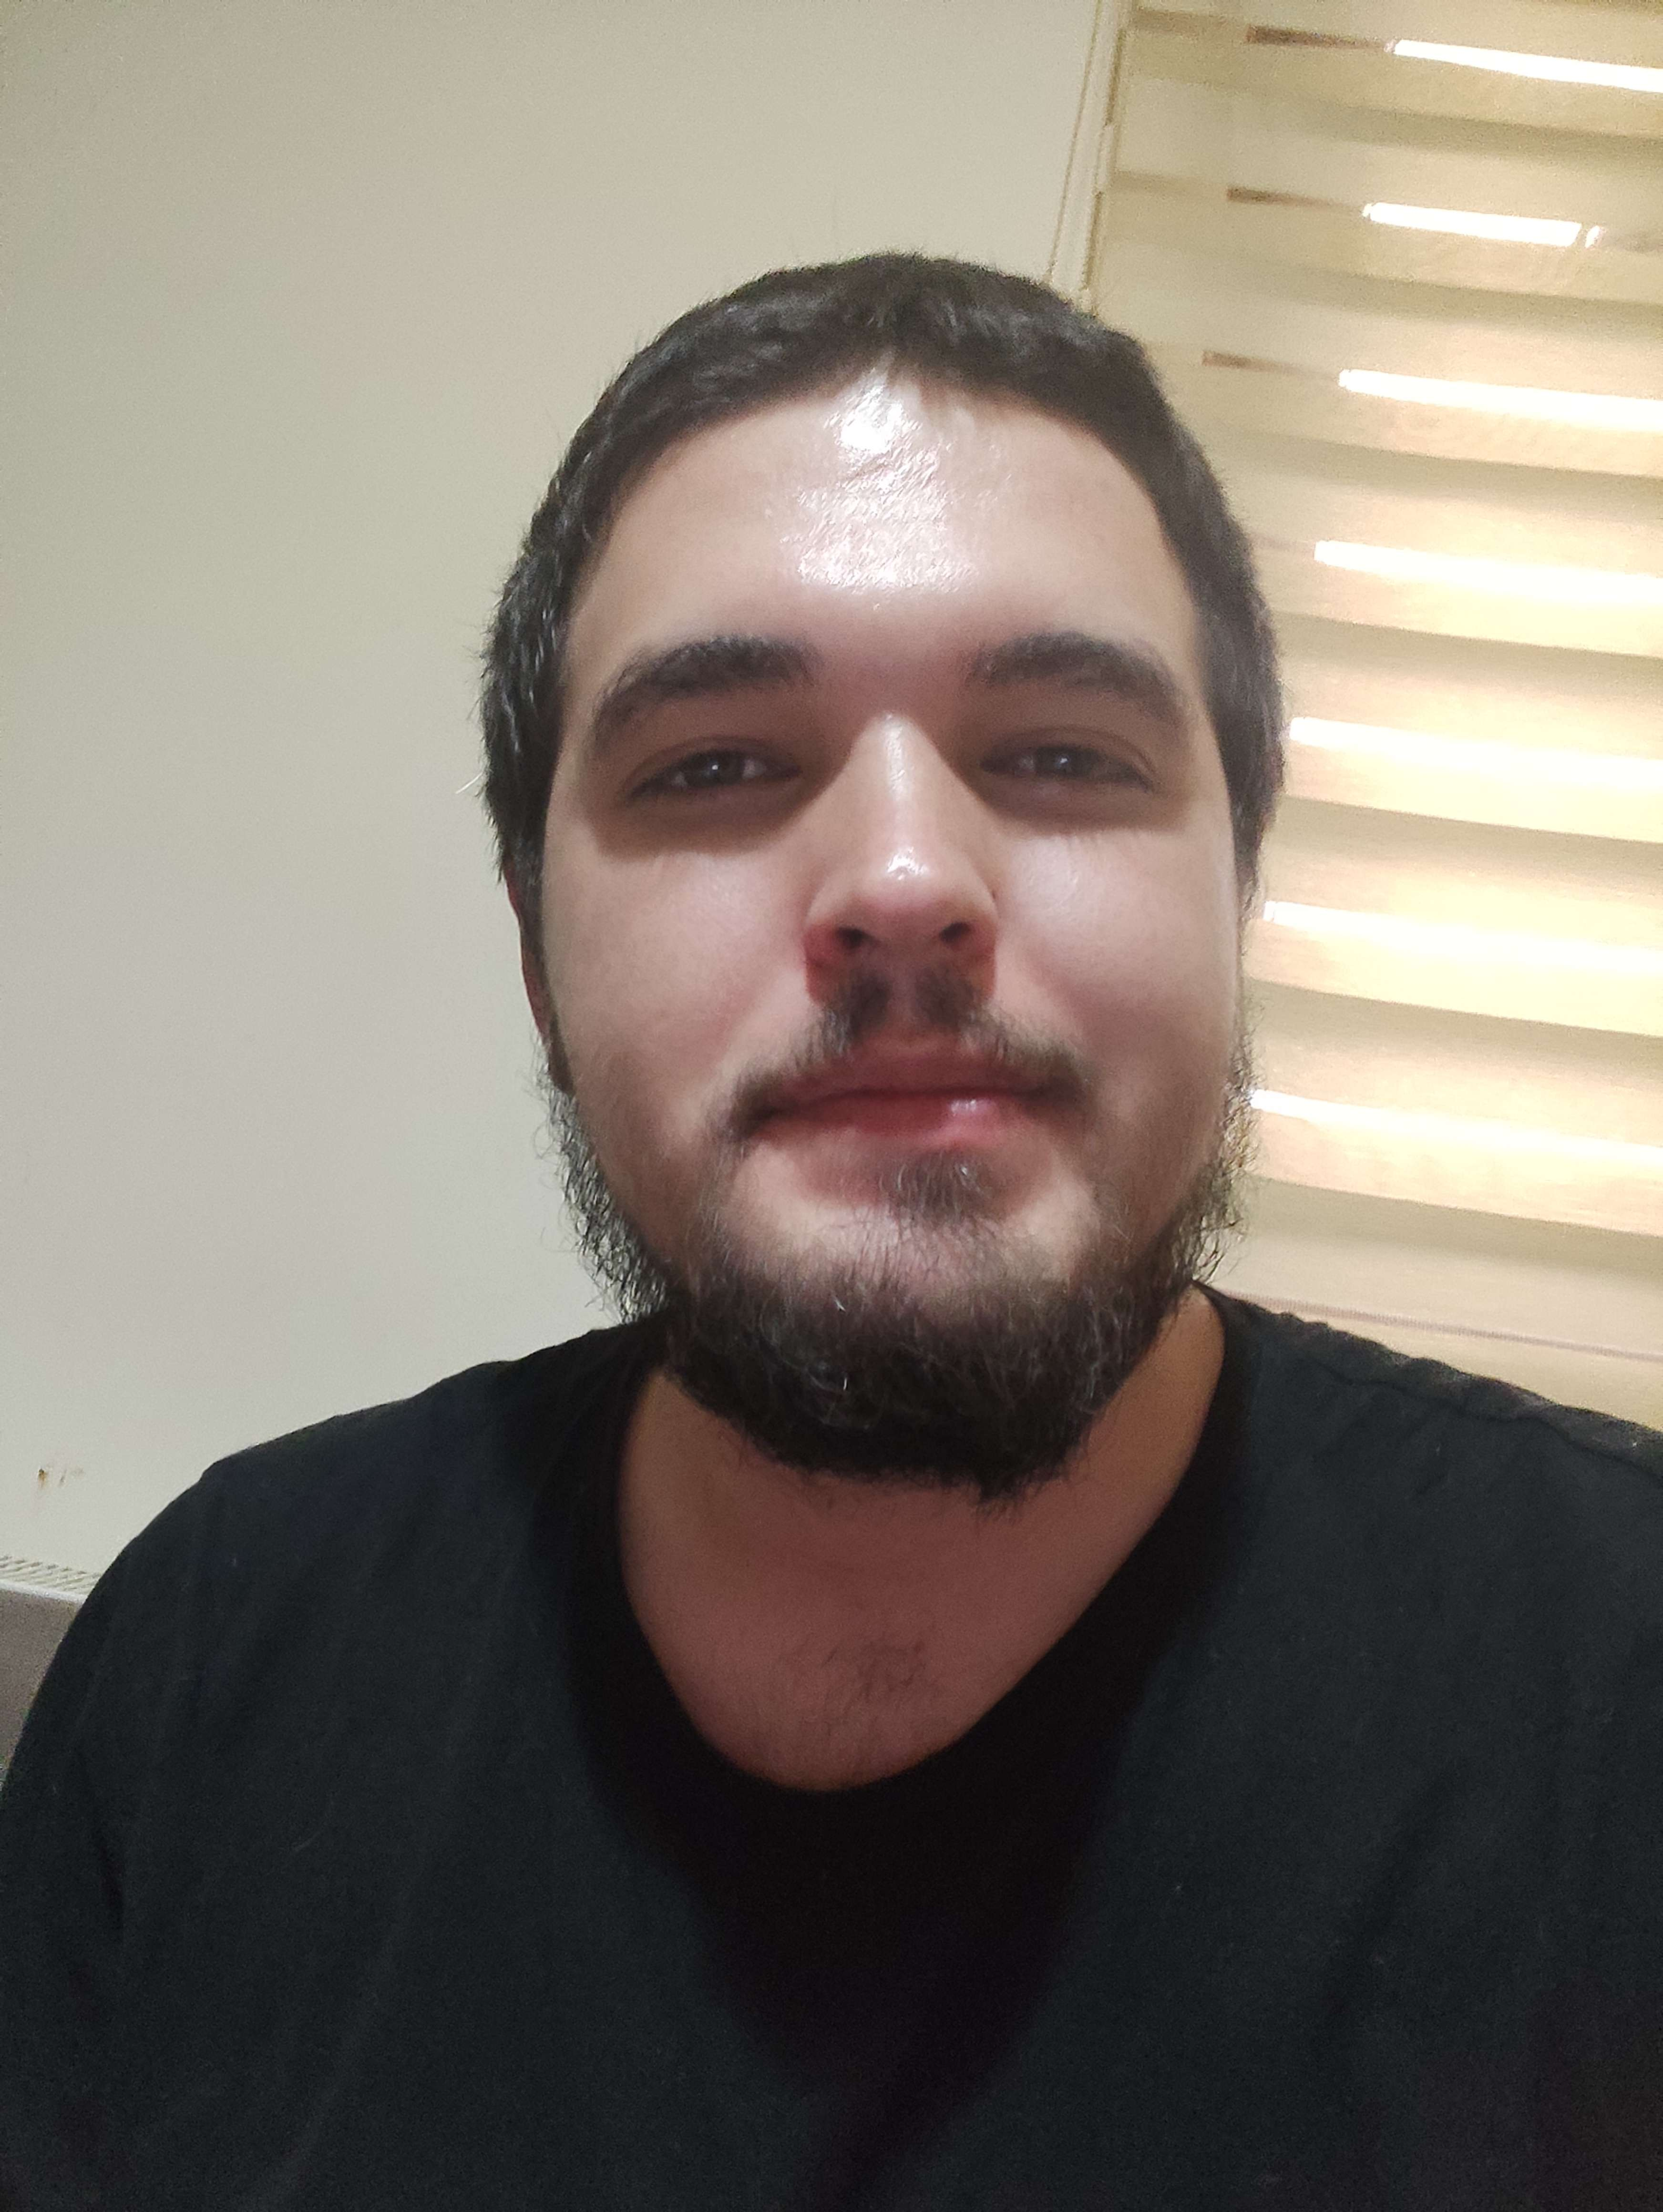
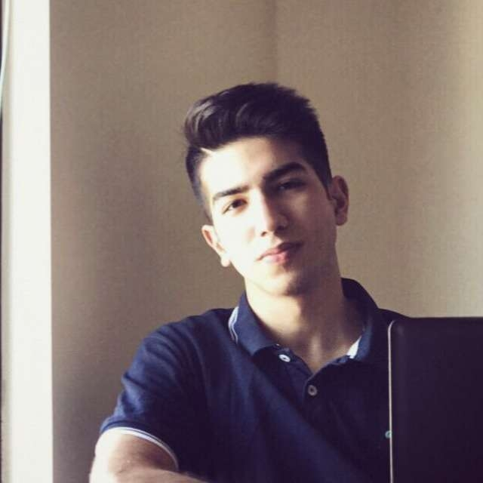

Karam Guliyev
(Team Leader)
Team Members
Adil Sadigov
Gabriel Kryemadhi
Hakan Tuncer
Rasam Rabiee
Koray Korkmaz

Slide 4
What is PancakeSwap?
PancakeSwap is a decentralized exchange built on the Binance Smart Chain that allows users to swap, trade, and farm their crypto assets in a deliciously simple way.
Why PancakeSwap Project?
We chose the PancakeSwap project because it has a user-friendly and engaging design, and presents a significant challenge even for larger teams due to its size and complexity.

Slide 5










What we used in this Project
ReactJS
HTML
SASS
JavaScript
CSS
Project Management
Platform:
Project Version
Control System:
Meetings Platform:
Trello
GitHub
Google Meet

Slide 6
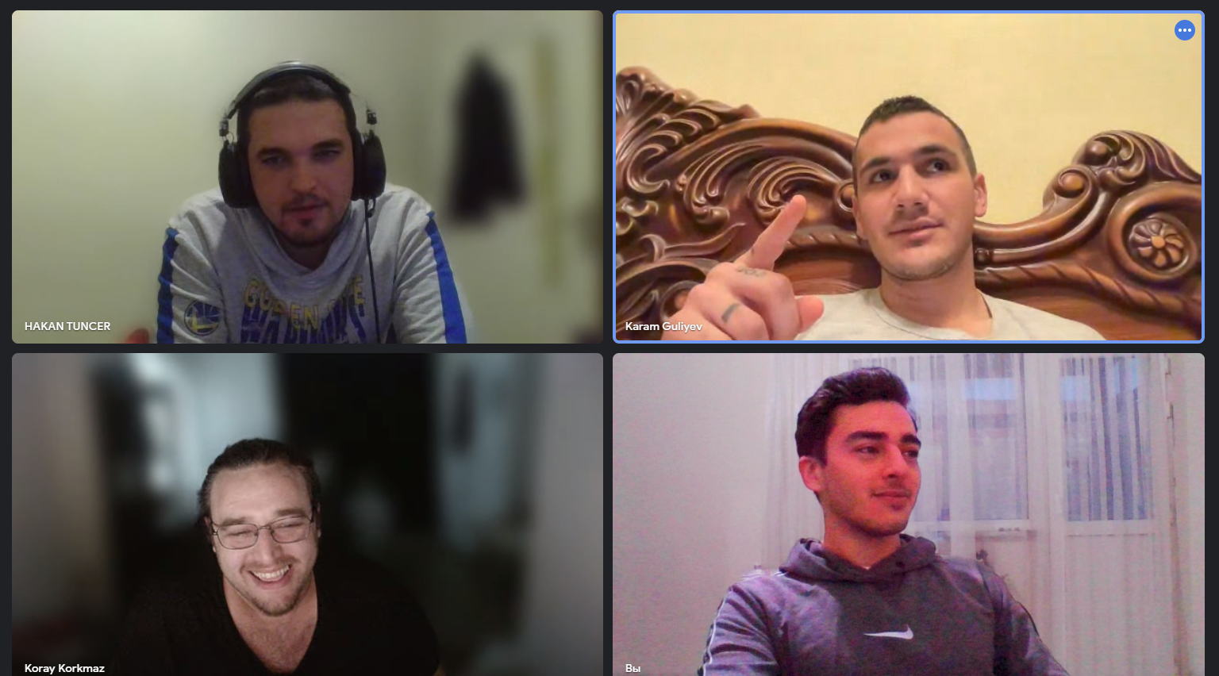
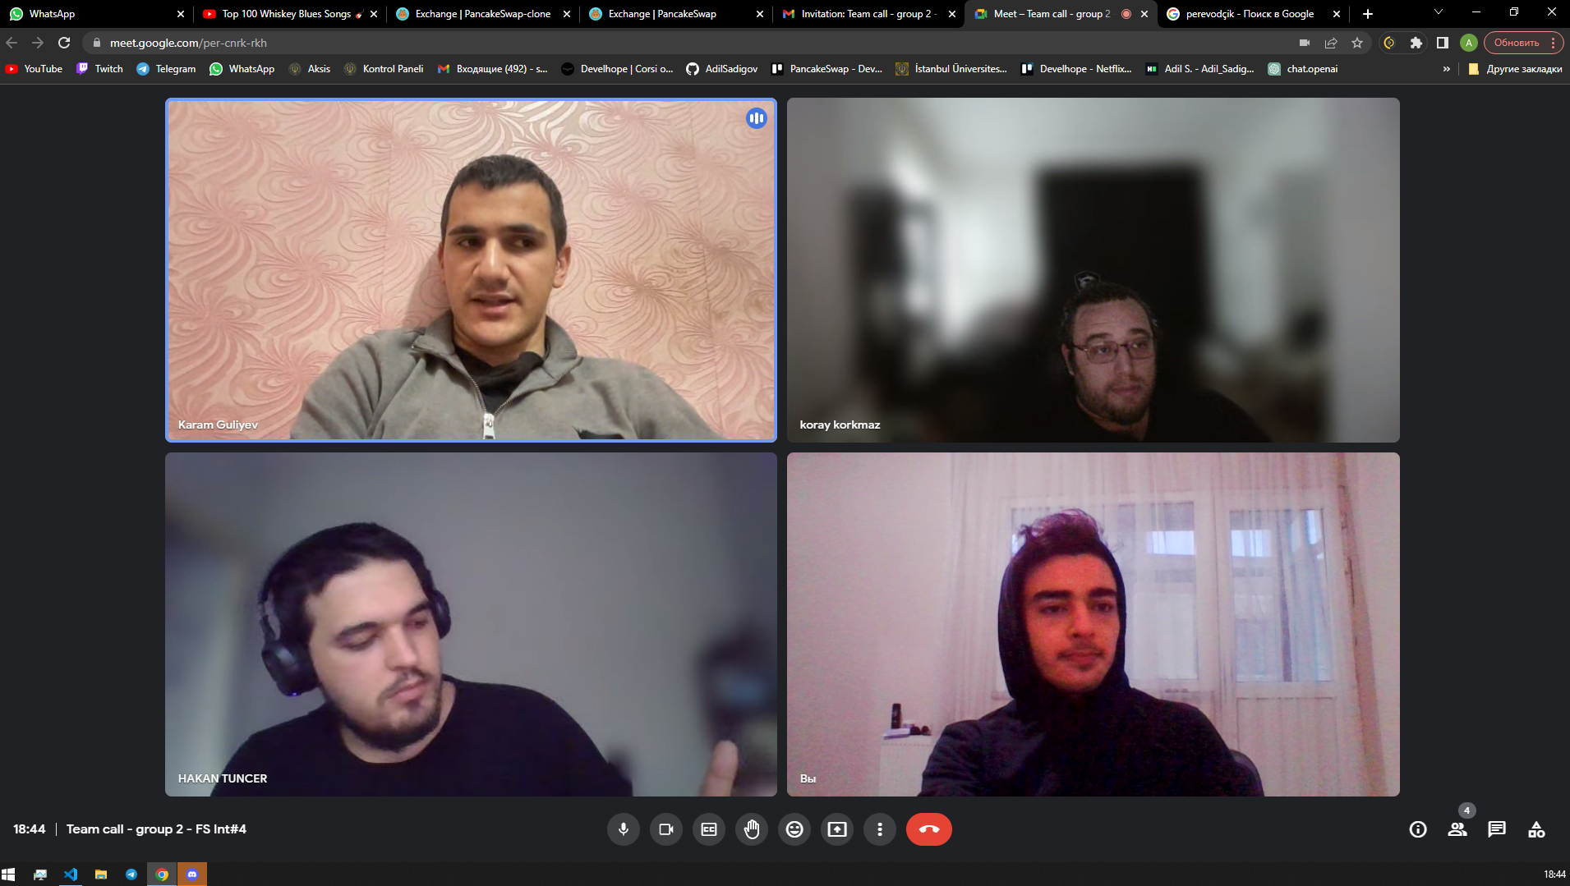
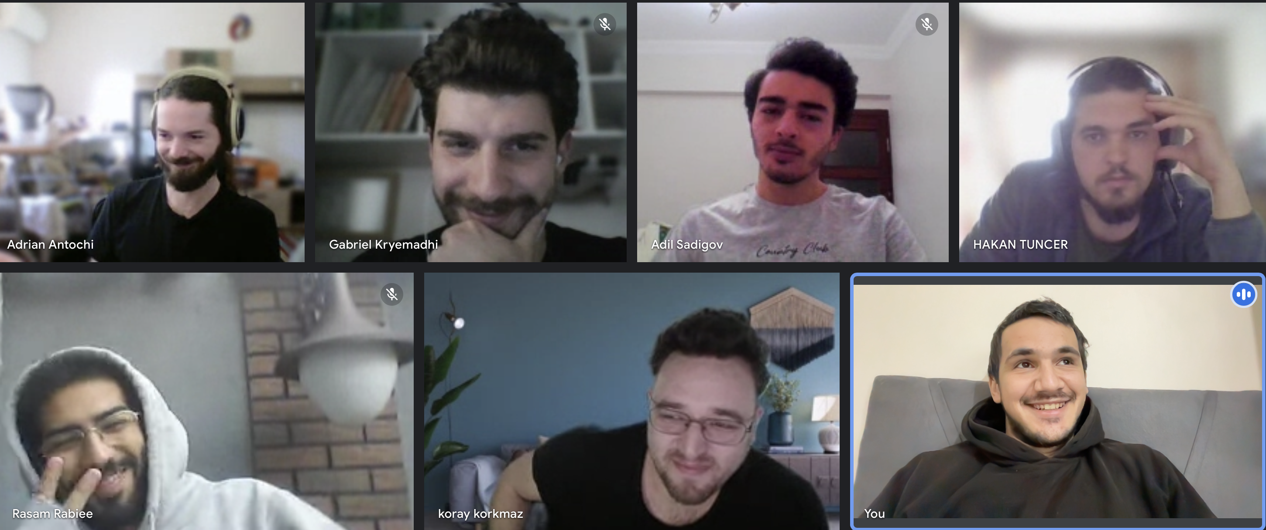
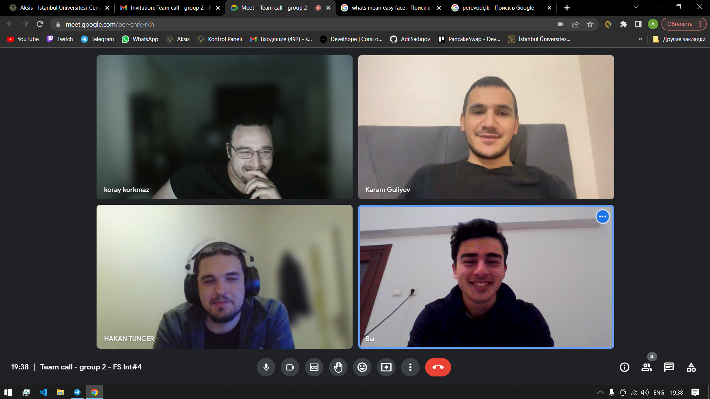
Group Meetings 3+1 per week
Feedback / Progress Track
Live Coding
Let’s have a real look at our website!
Team Meetings
Updates

Slide 7
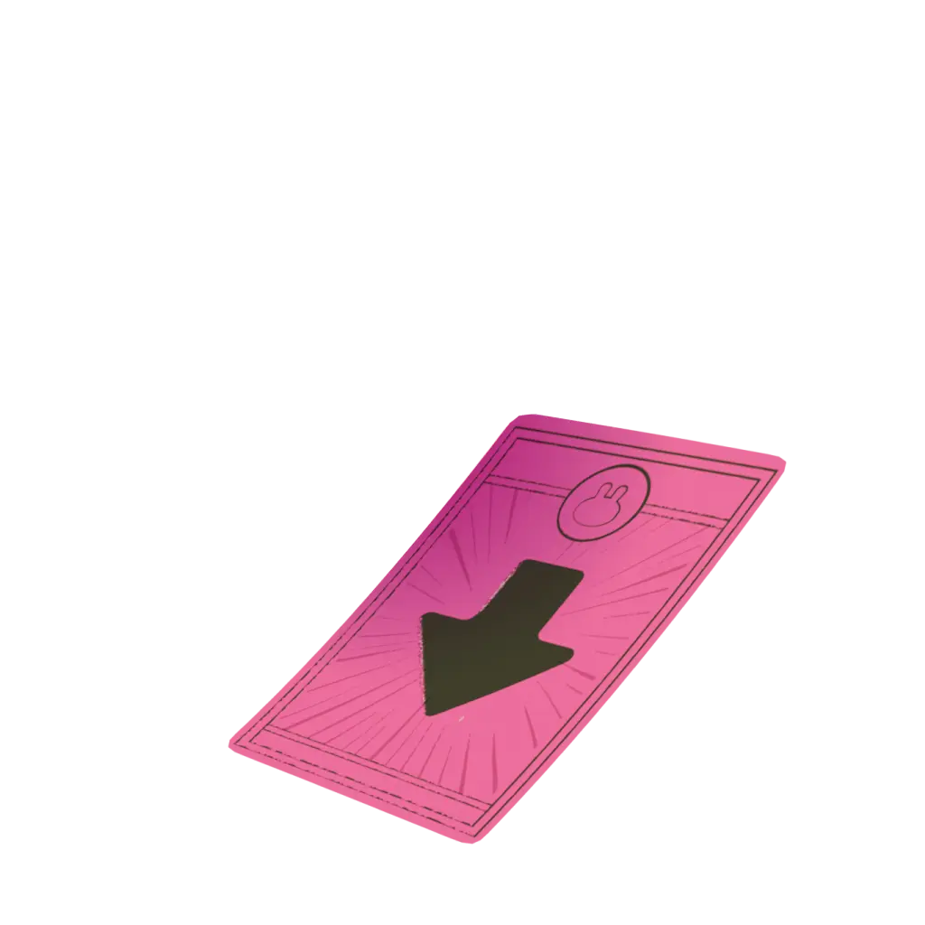

Let’s have a real look at our website!

Slide 8
Thank You
for your attention!
Let’s have a real look at our website!
We’re open to Questions, Comments and Feedbacks.

